Slide 1
Nexthikes project-1
“Simple calculator using python”
Introduction:
“This project is simple calculator created using Pyhton’s Tkinter library ,capable of performing
basic arithmetic operations and advanced functions like square, square root, and memory
operations”.
Purpose:
“The calculator is designed to handle essential operations , such as addition, subtraction,
multiplication, and divisions, while also offering advanced functionalities like square, square root, cube root, reciprocal, and percentage operations”.
Visuals:
Icons representing each features(like a plus sign for addition, square root for the advanced operations, etc.).

Slide 2
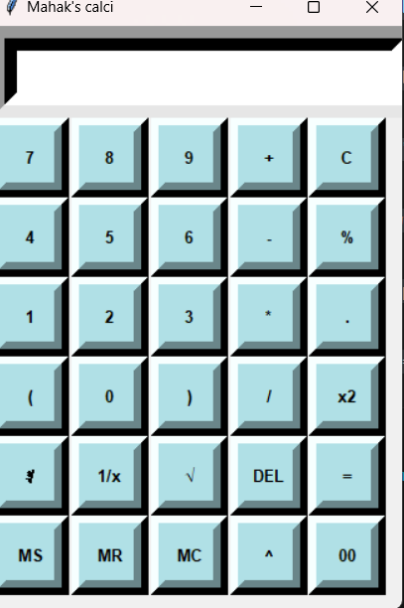
“Calculator features and key functions”. Key features:
Basic features:
Addition, subtraction, multiplication, division
Square, square root, cube root, and reciprocal functions
Percentage and exponentiation operations
Memory functions:
Memory Save(MS)
Memory Recall(MR)
Memory Clear(MC)
Error Handling :
Handles invalid inputs like division by zero.
User Interface:
Buttons for digits (0-9) and operations.
Clear and delete functionalities.

Slide 3
“How the Application Works”
Content:
User Interaction:
User inputs numbers and operations via buttons.
Operation Evaluation:
The calculator uses the eval () function to calculate the result of the mathematical
expression entered by the user.
Advanced Operations:
Special operations like square, square root, reciprocal, and cube root are performed using
specific functions.
Memory Functions:
Results can be stored and recalled using memory functions(MS, MR, MC).
Error Handling:
Errors such as division by zero are handled and displayed as “Error”.

Slide 4
Thank you

